Slide 1




LOG TRACING in microservices architecture
ARVIND
#1
SPRING CLOUD SLEUTH AND ZIPKIN

Slide 2
Real life problem
Issue on web
Support people
Maintenance team
QA
Developer
Application log for analysis

Slide 3
Microservices architecture & Request tracing
DoctorService
Doctor Portal
PatientService
Notification
Service
DiseaseService

Slide 4
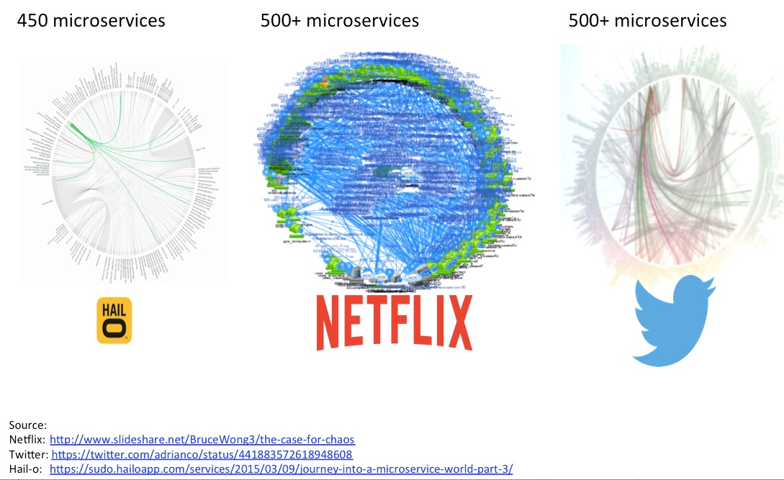

Slide 5
DISTRIBUTED LOG TRACING SYSTEM Spring cloud sleuth introduction
ARVIND
#2

Slide 6
What is it??
Spring Cloud Sleuth implements a distributed tracing solution for Spring Cloud

Slide 7
Terminology
Span:
The basic unit of work.
unique 64-bit ID
Also have metadata
Trace:
A set of spans forming a tree-like structure.

Slide 8
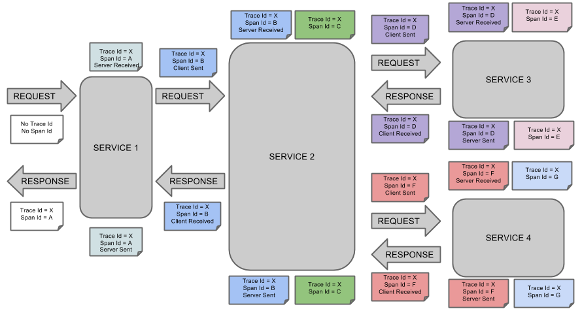
Diagram

Slide 9
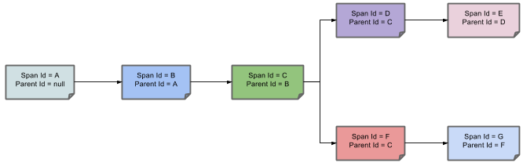
Diagram..

Slide 10
Microservices architecture & Request tracing
DoctorService
Doctor Portal
PatientService
Notification
Service
DiseaseService

Slide 11
DISTRIBUTED LOG TRACING SYSTEM spring cloud Sleuth demo with spring boot
ARVIND
#3

Slide 12
Microservices architecture & Request tracing

Slide 13
Microservices architecture & Request tracing

Slide 14
Microservices architecture & Request tracing

Slide 15
Microservices architecture & Request tracing

